Slide 1

Deep Learning Models for Stock Trading
Beau Spratt, Matthew Smith, Matthew Spitulnik, and Sintia Stabel

Slide 2
AGENDA
Introduction to Deep Learning in Stock Trading
CNNs Over Synthetic Images
Deep Learning Models Leveraging Various Indicators
Text Mining and Stock Price Increase Prediction
Reinforcement Learning for Portfolio Trading
Reinforcement Learning and LSTM Combination
Conclusion and Future Directions
Q&A

Slide 3
Introduction to Deep Learning in Stock Trading
Brief overview of the use of deep learning in stock trading
Importance of deep learning models
Chart: Deep Learning Impact on Stock Trading

Slide 4
Deep Learning Models Leveraging Various Indicators
Utilizing various stock market indicators with deep learning models
Examples of indicators (e.g., moving averages, RSI)
Diagram: Integration of indicators with deep learning

Slide 5
CNNs Over Synthetic Images
Beau Spratt IST 691

Slide 6
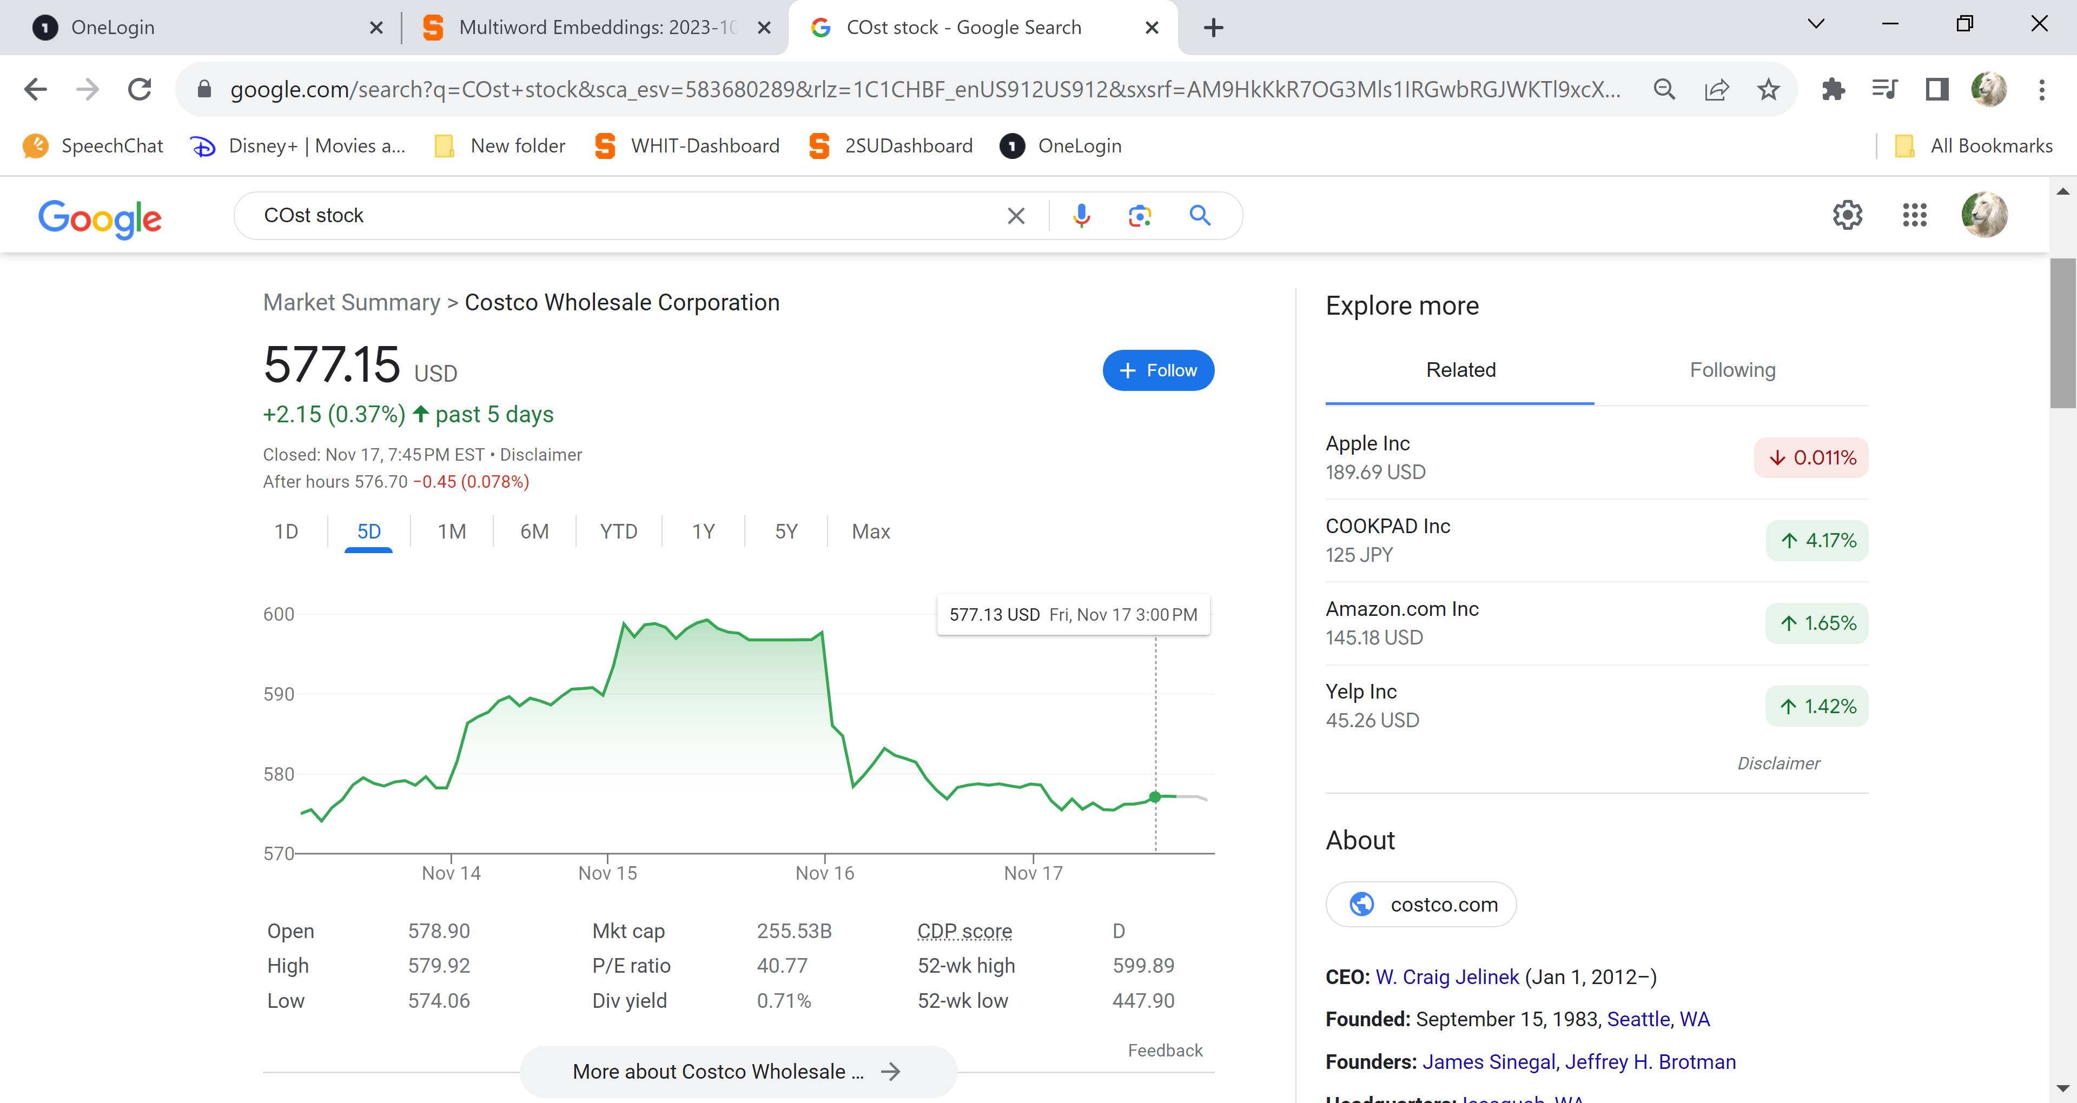
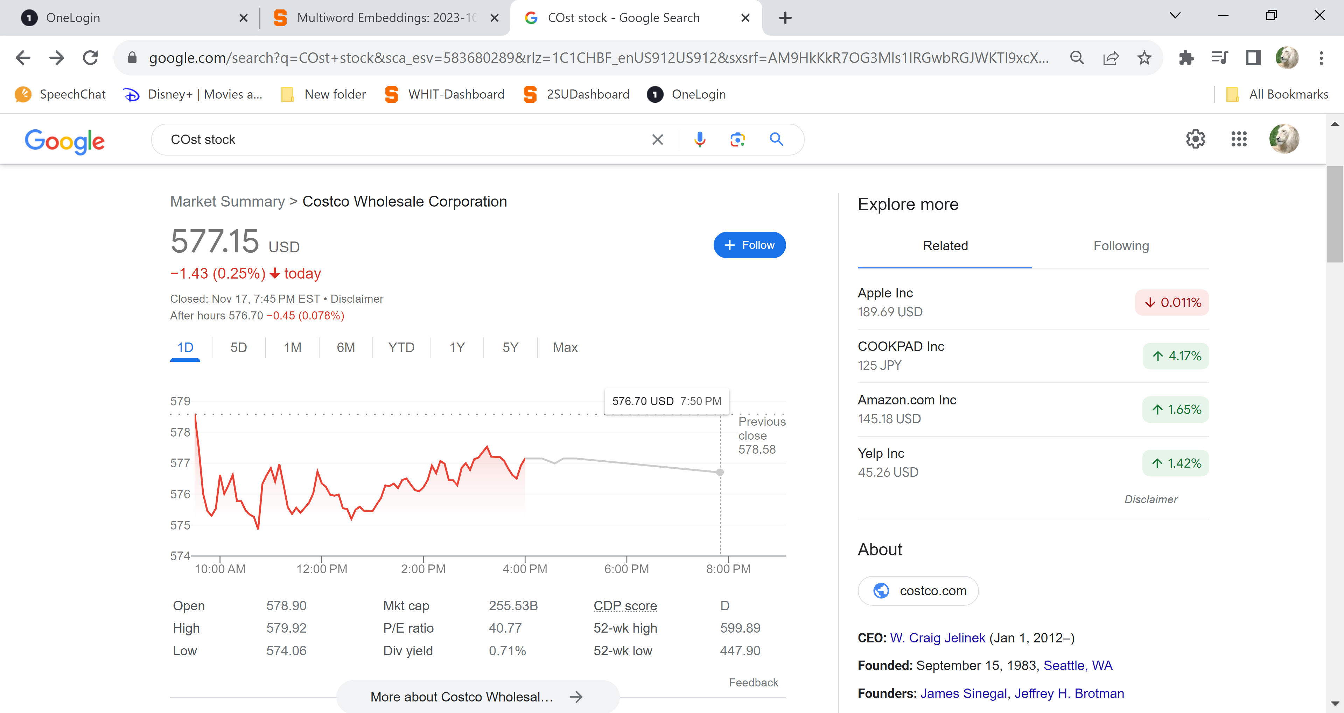
Next Day/Minute Closing Predictions Basics
Predict
100 months Training
7days Training
Predict

Slide 7

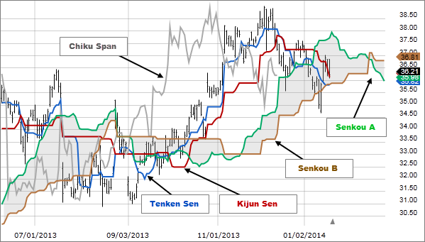
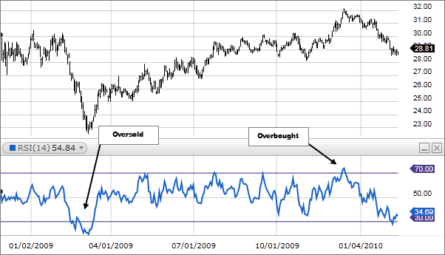
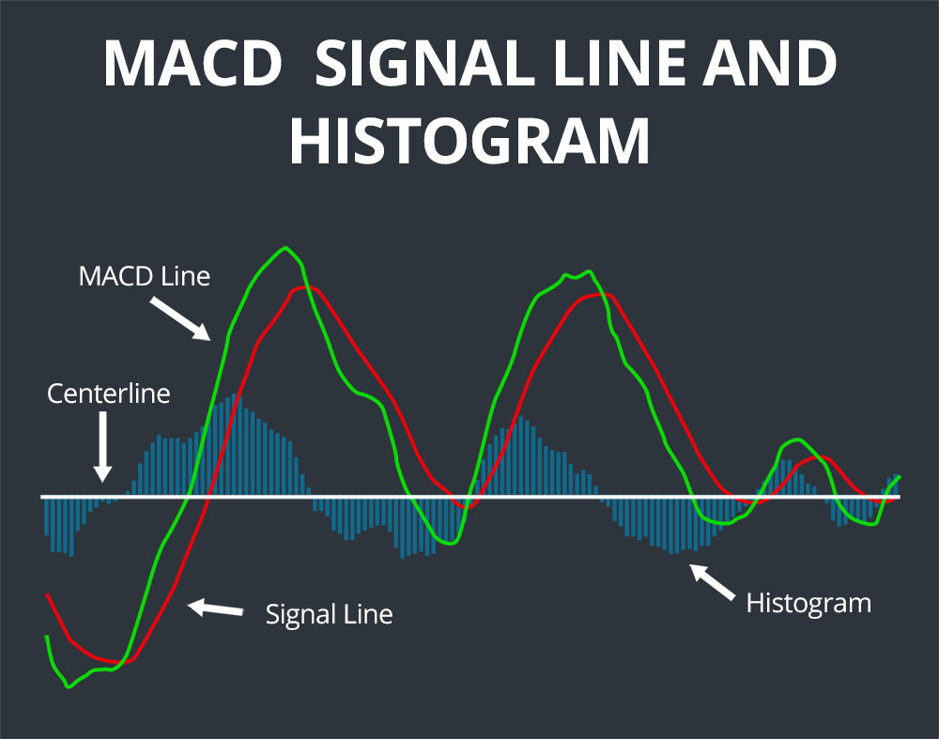
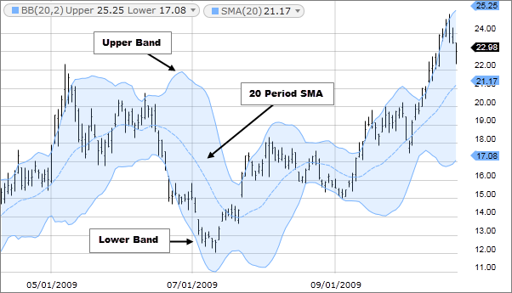
Testing Parameters & Technical Indicators
Day to Day: 100 months
Minute to Minute: 7 days
Ichimoku
RSI (relative strength index)
This Photo by Unknown Author is licensed under CC BY-SA-NC
# Ichimoku components
tenkan_period = 4
kijun_period = 13
senkou_period = 26
#Image attributes
image_width = 20
# Calculate MACD
short_window = 12
long_window = 26
macd_signal = 9
# Bollinger Bands
period = 20
stdev = 2
Bollinger Bands
#Model attributes
n_steps = 16
learning_rate = 0.0001
epochs=100
batch_size=16
#Moving Average
ma_period = 10
#Relative Strength Index
rsi_period = 7
Notes:
Ichimoku Cloud (Ichimoku Kinko Hyo):
Purpose: Used to gauge momentum and identify trend directions.
Relative Strength Index (RSI):
Purpose: Measures the speed and change of price movements, identifying overbought or oversold conditions.
Bollinger Bands:
Purpose: Measures market volatility and identifies overbought or oversold conditions.
Moving Average Convergence Divergence (MACD):
Purpose: Used to identify moving averages that indicate a new trend, whether it's bullish or bearish.
https://www.fidelity.com/learning-center/trading-investing/technical-analysis/technical-indicator-guide/RSI
https://commodity.com/technical-analysis/macd/
https://scanz.com/macd-indicator-guide/
https://www.fidelity.com/learning-center/trading-investing/technical-analysis/technical-indicator-guide/Ichimoku-Cloud

Slide 8
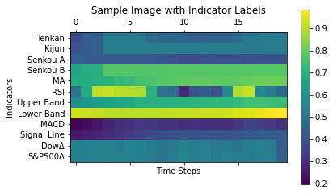
Synthetic Input Image (heatmap)
Width: 20 consecutive days or 20 minutes
Future Additions:
Fundamentals, News, Shadowing

Slide 9
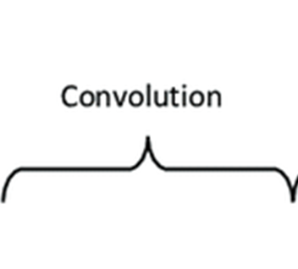
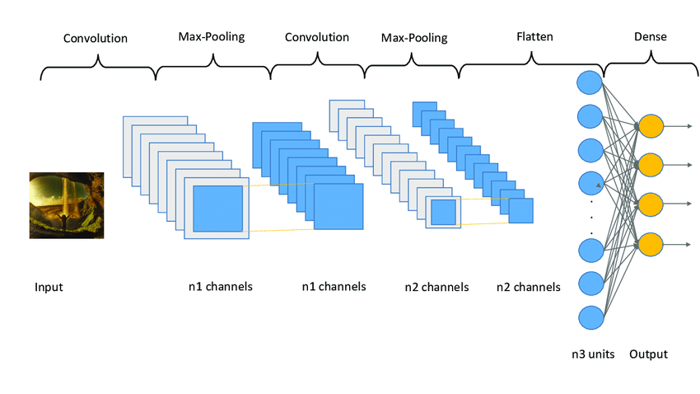
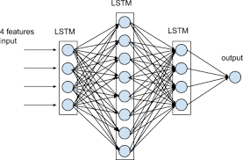
Model Architecture CNN+RNN+DENSE
Convolutional Neural Networks And Unconventional Data - Predicting The Stock Market Using Images
Data Exploration & Machine Learning, Hands-on (amunategui.github.io) © Manuel Amunategui
© Manuel Amunategui
Input Image
Convolution
Pooling
Flatten
LSTM
Dense
Closing Price
$521.12

Slide 10
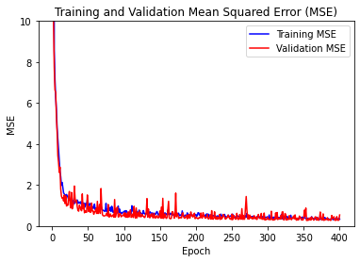
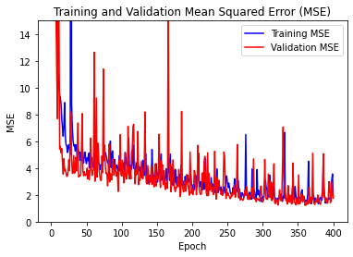
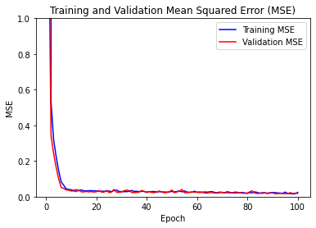
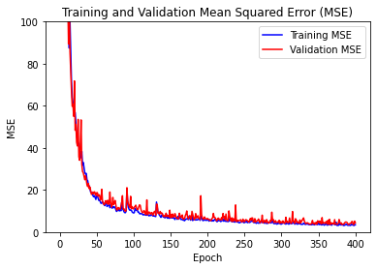
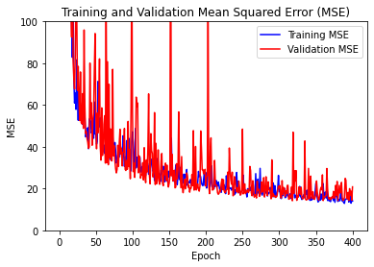
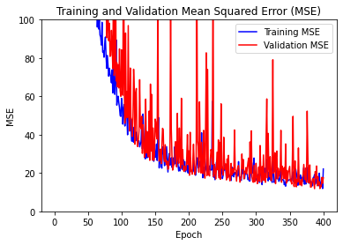
Stocks &Training Difficulty (varied epochs and learning rates)
BWXT
GME
KGC
AAPL
TSLA
COST

Slide 11
CNN-RNN Results
Day to Day
Minute to Minute
Stock | Price | D2D MSE | % Error | Correct Week/OVR | M2M MSE | % Error | Correct UP/Down
AAPL | $188.01 | 2.01 | 1.1% | 64/51 | 0.013451 | 0.0072% | 53.0%
TSLA | $242.84 | 14.02 | 5.8% | 45/51 | 0.16646 | 0.0685% | 50.0%
COST | $596.78 | 11.01 | 1.8% | 41/53 | 1.166733 | 0.1955% | 50.2%
BWXT | $76.39 | 0.50 | 0.7% | 59/50 | 0.017204 | 0.0225% | 44.9%
KGC | $5.32 | 0.018 | 0.3% | 50/45 | 0.0007 | 0.0132% | 50.0%
GME | $12.80 | 1.75 | 13.7% | 57/48 | 0.0009 | 0.0070% | 44.1%

Slide 12
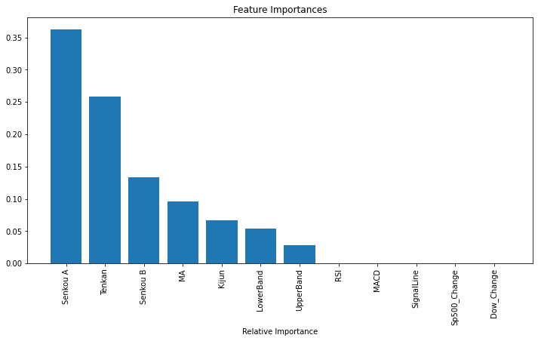
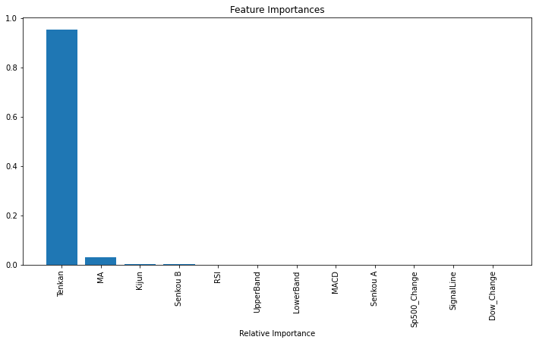
Trying Random Forest (for comparison)
data = yf.download(ticker, period="100mo", interval="1d")
model = RandomForestRegressor(n_estimators=100, random_state=42)
AAPL
MSE 5.18
TSLA
MSE 65.82

Slide 13
CNNs Over Synthetic Images - Conclusions
Tons of parameters to optimize for each stock
Each stock reacts differently to the model
Several features can be added to one image
Fast Training/Testing Times (architecture can be minimal)
Provides improved results over more basic models

Slide 14
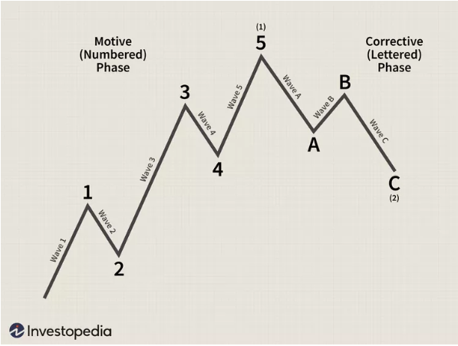
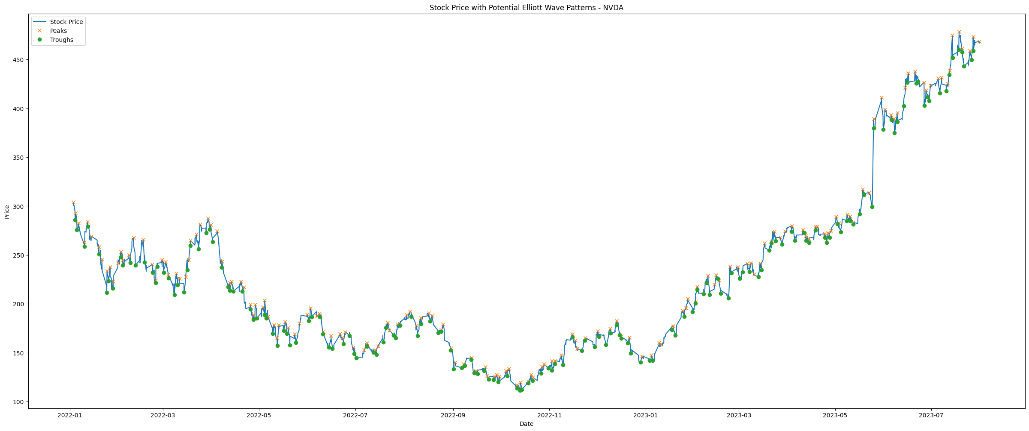
Elliot Wave Theory
- Theory recognized that stock prices move in waves
- Peaks and troughs identified in stock data

Slide 15
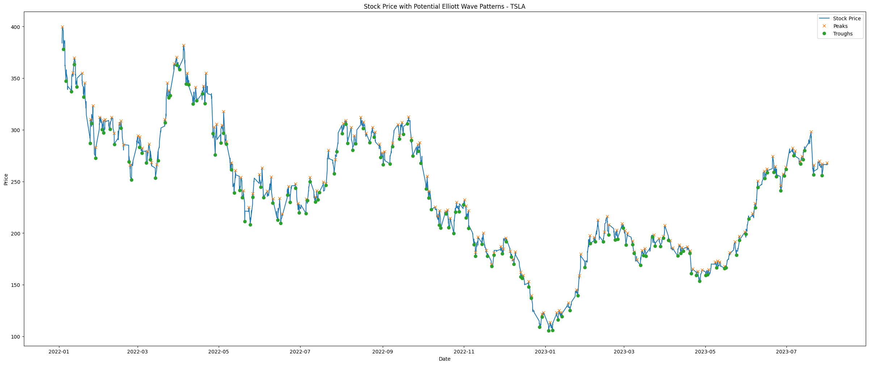
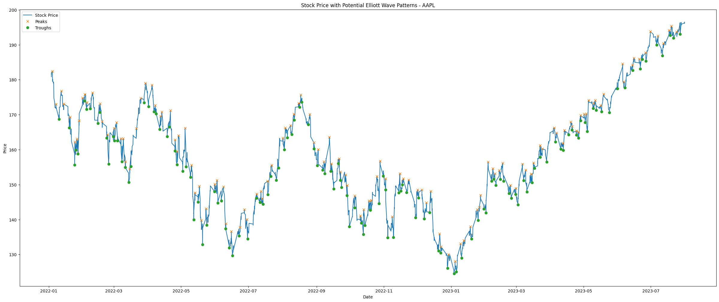
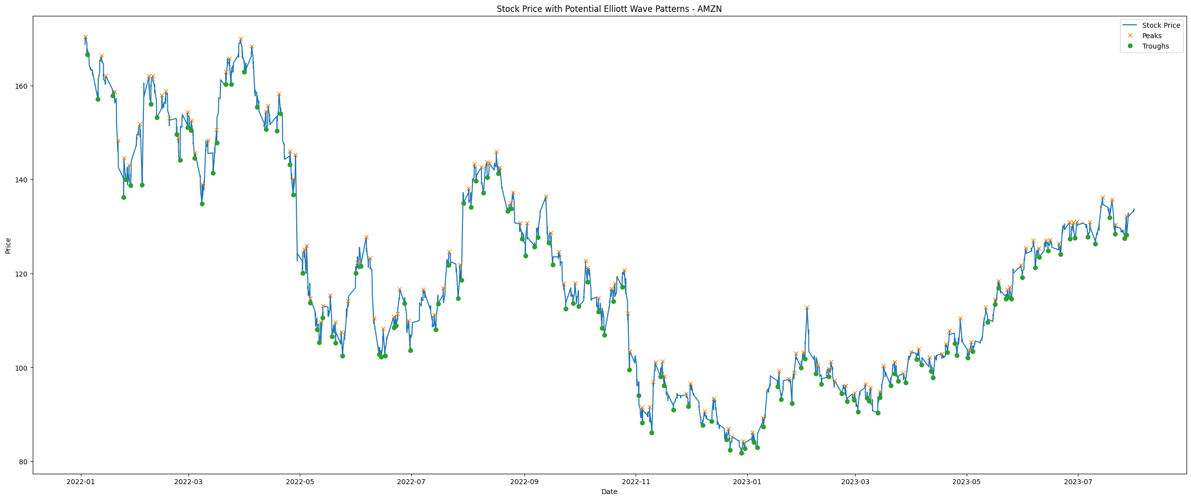
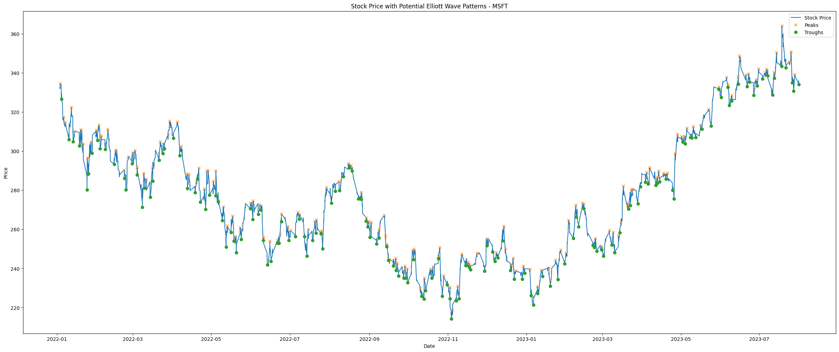
NVDA
Created Features:
- peaks
- troughs
- Wave Status (1:trough, 2:peak)
- Wave Length
- Wave Amplitude
TSLA
AAPL
AMZN
MSFT

Slide 16
Model Architecture (CNN + LSTM)
(Input – 48)
(Output – 12)
CNN
LSTM
LSTM
...
...
Tanh
Tanh
Tanh

Slide 17
Model Architecture (CNN + GRU)
(Input – 48)
(Output – 12)
CNN
GRU
GRU
...
...
Tanh
Tanh
Tanh

Slide 18
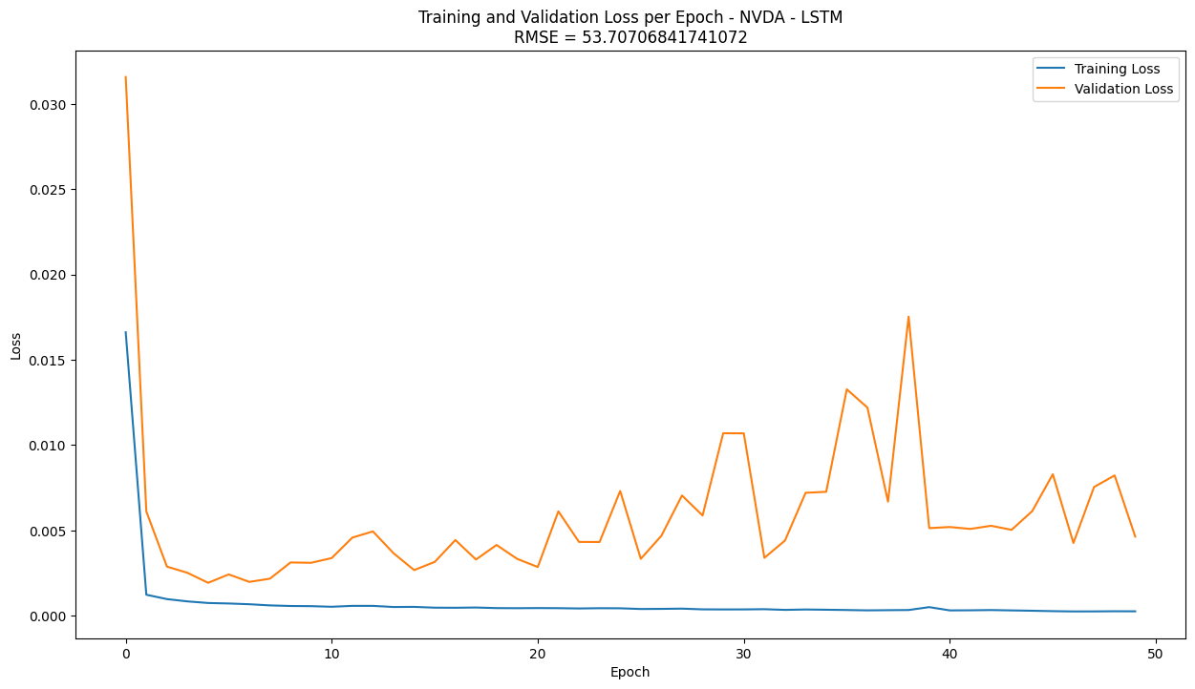
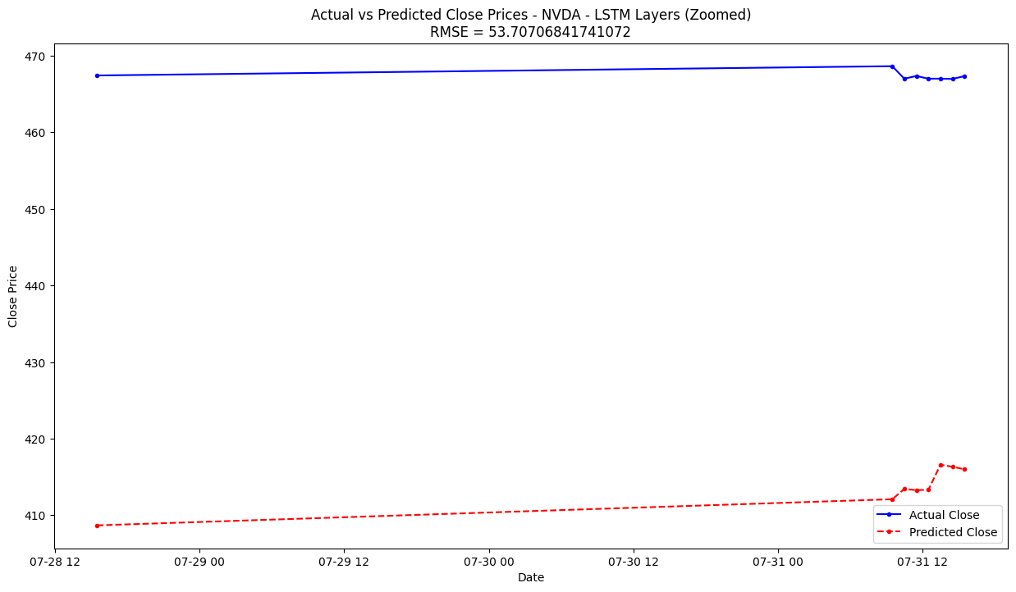
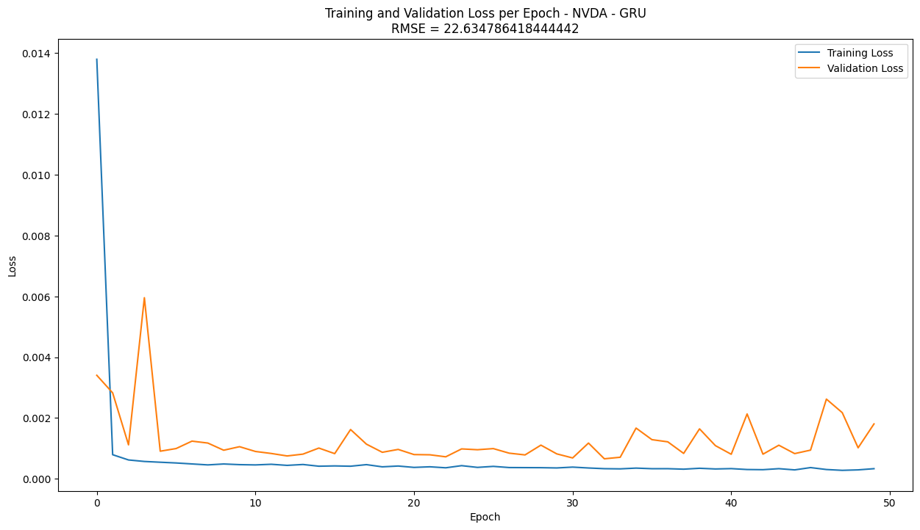
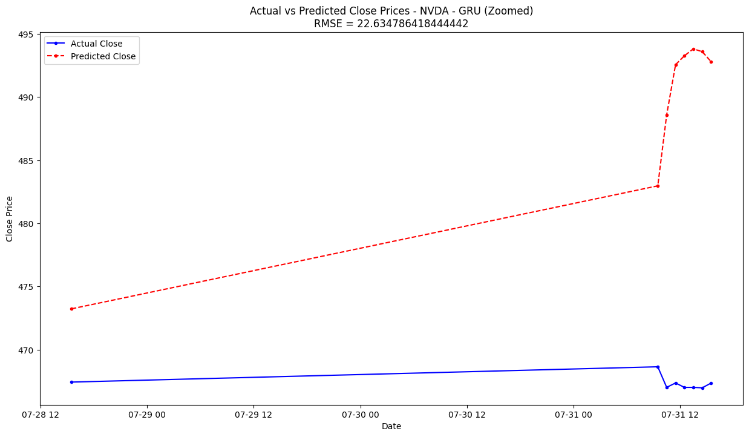
CNN + LSTM vs. CNN + GRU (with Elliot Waves features)
RMSE ~ 53.71

Slide 19
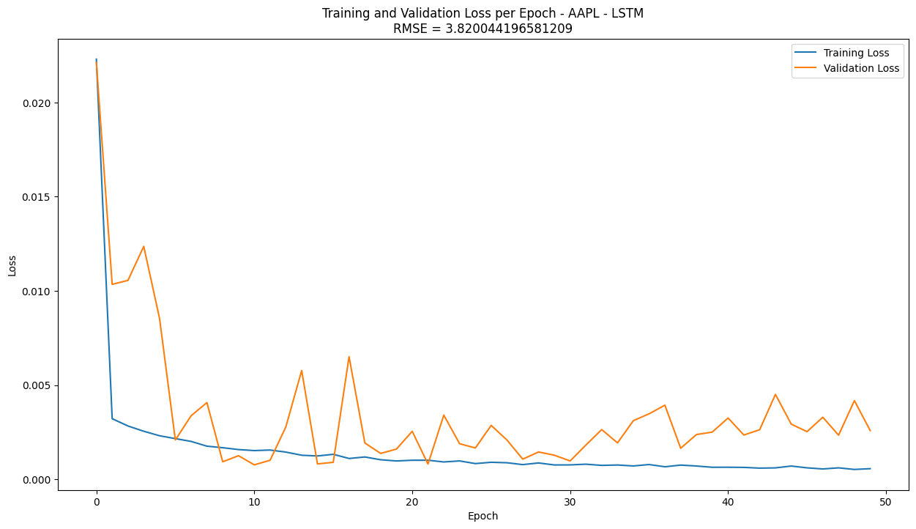
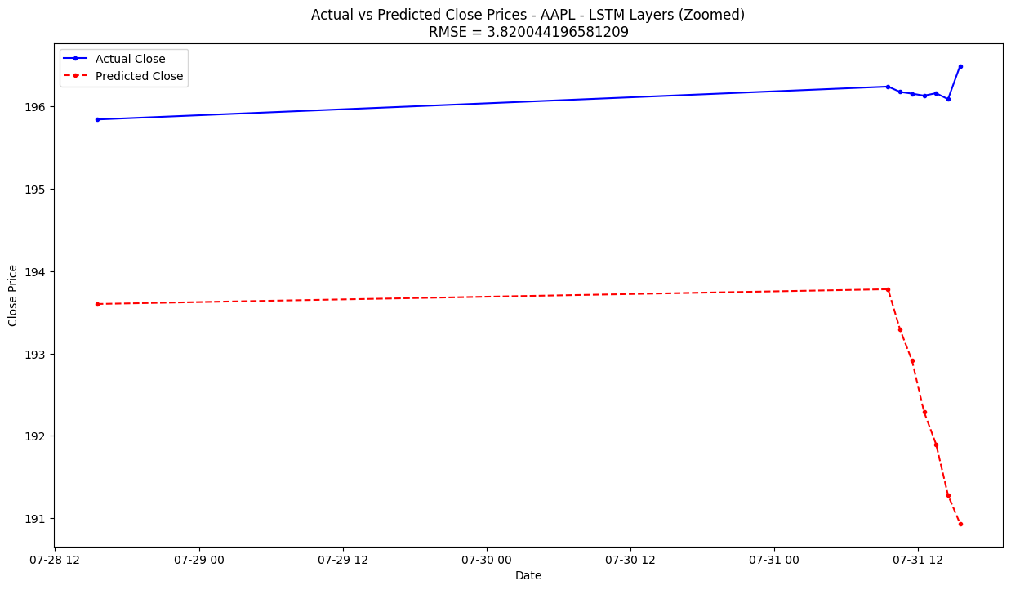
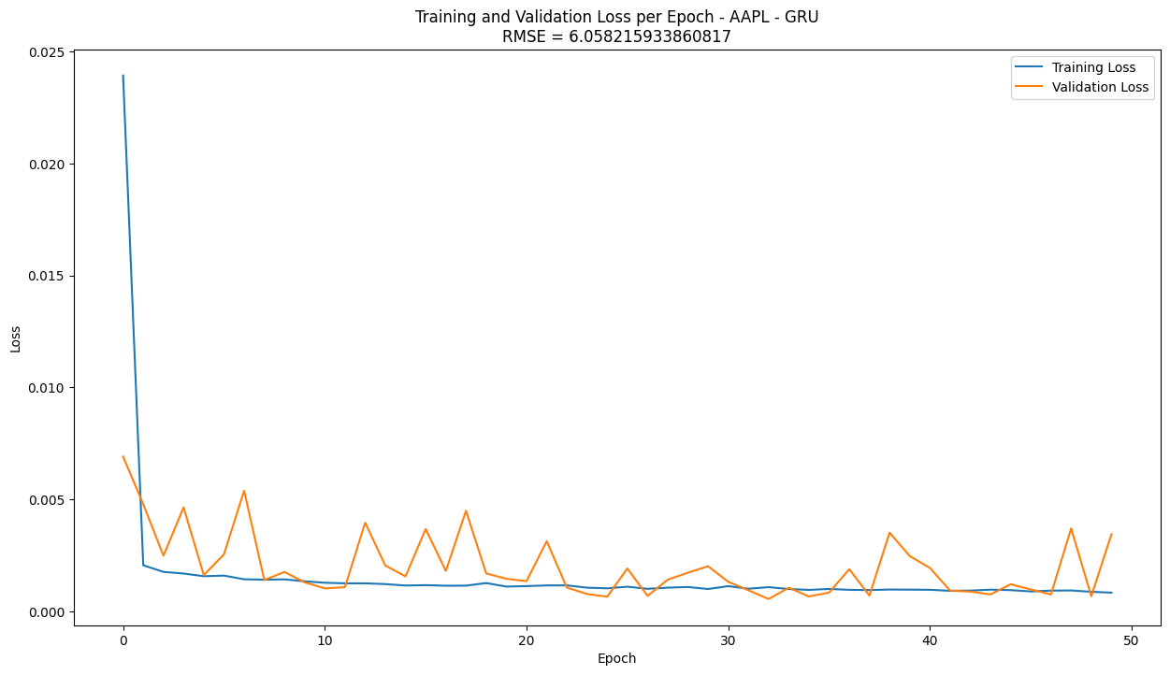
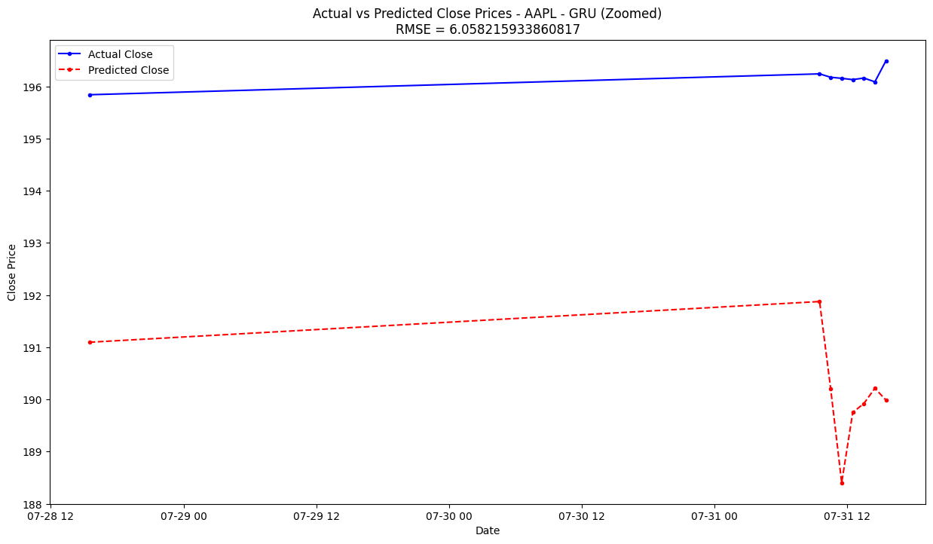
CNN + LSTM vs. CNN + GRU (with Elliot Waves features)
RMSE ~ 3.82

Slide 20
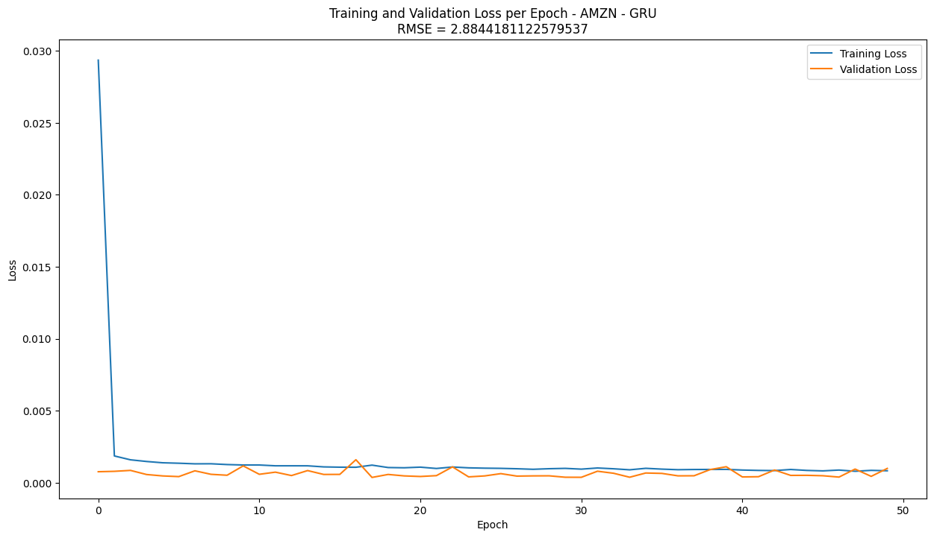
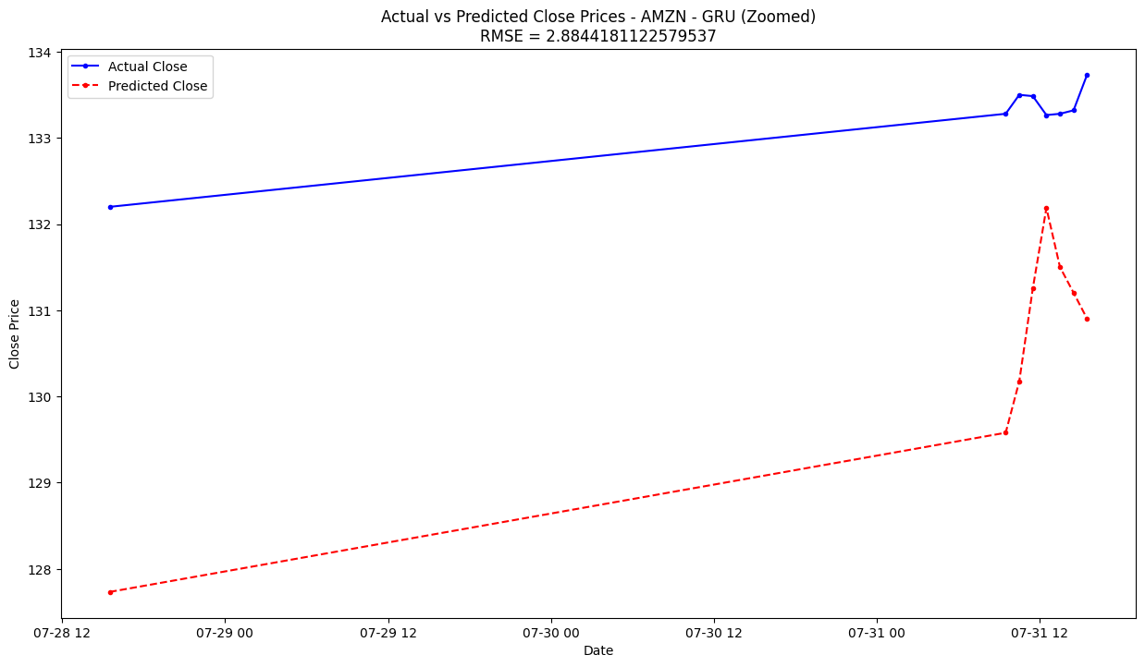
CNN + LSTM vs. CNN + GRU (with Elliot Waves features)
RMSE ~ 2.88

Slide 21
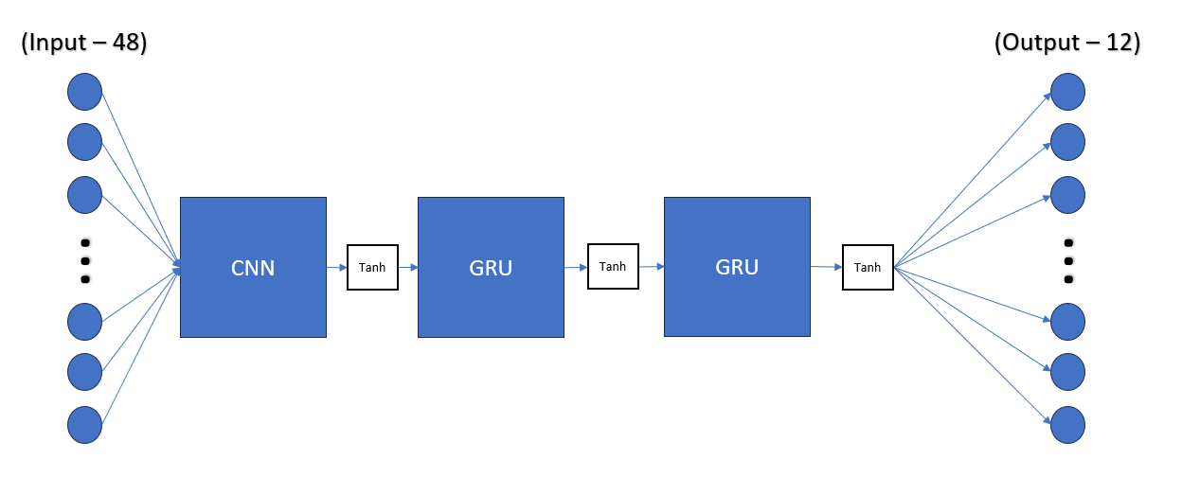
Are GANs suitable for predicting stock prices?
Real Data
Discriminator
Model
(GELU)
Data
Discriminator
Loss
Generator
Model
(GELU)
Data
Generator
Loss
Random Input
[[123],[456],[789]]
CNN + GRU
Fekri, M. N., Ghosh, A. M., & Grolinger, K. (2019). Generating Energy Data for Machine Learning with Recurrent Generative Adversarial Networks. Energies, 13(1), 130. https://doi.org/10.3390/en13010130
Generator backpropagation
Discriminator backpropagation

Slide 22
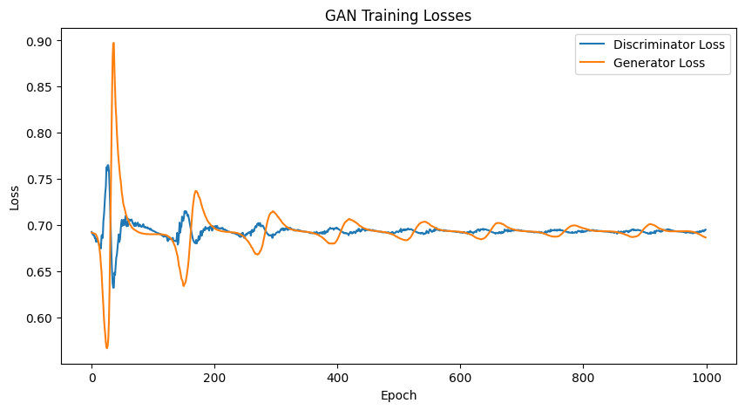
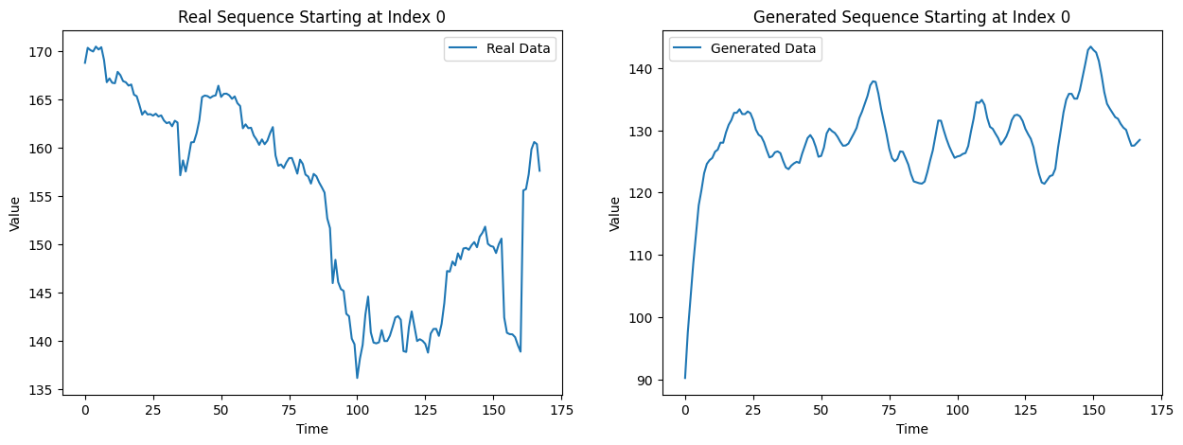
Not so far....
Generated data appear to get better with each step-up in the amount of training epochs, but the right number has yet to be reached
Ending up being a computing power/time available problem.
Further tweaks to the Discriminator/Generator models needed:
- Loss drop value for discriminator,
- Activation function combinations for each
- Number of layers for discriminator/generator models (GRU vs. LSTM?)
- Maybe using a different optimizer would help? (Used Adam() for current results)
Model in original paper utilized pre-processing steps not used here:
-> ARIMA features
-> Fourier Transform
-> Normalize (used)
-> Sliding Window

Slide 23
CNN + LSTM vs. CNN + GRU vs. R-GAN conclusions
Different stocks reacted differently between LSTM and GRU-based models:
'AMZN' had best RMSE with GRU-model.
'AAPL has best RMSE with LSTM-model.
Single model methods perform better than vanilla R-GAN (either not the right adjustments to parameters or just not enough time to train model properly).

Slide 24
Text Mining and Stock Price Increase Prediction
The question to answer: Can the text from news articles about stocks be used to predict whether a stock price will increase or decrease?
Method to answer: Compare the opening price of the stock the day the article is released (day 0) to the opening price of the stock the following market day (day 1).
Note: Used the opening price of day 0 instead of the closing price to increase the likelihood that the article had not yet affected the price.

Slide 25
The Data
Used sites like investopedia.com, seekingalpha.com, and marketwatch.com to compile list of ~500 trending stocks.
Built a function that used the trending stock list to attempt to collect news articles about each stock from investing.com.
The stock name/ticker and the date the article was released was then used along with the YahooFinance API (yfinance) to collected the day 0 and day 1 opening prices.
Ultimately, 8740 articles/prices could be located for 325 different stocks.

Slide 26
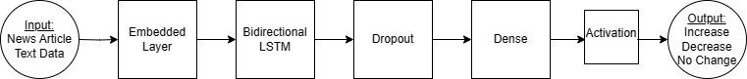
Base Model

Slide 27
Model Variations
66 different models were run with the following variations:
Input: raw vs. processed, max_len, num_words, test_size
Embedded: self vs. pretrained, mask, output_dim
LSTM: Number of units
CNN Layer (Conv1D) + MaxPooling1D?
2nd Dense Layer?
Various activation functions, compile optimizers, and compile loss options
Learning rates and regularizations
Validation splits and number of epochs

Slide 28
Raw Text Vs. Preprocessed
Raw Text:
# of words per article: ~408
Max # of words: 14424
Example article:
"Â\xa0 Investing.com - 23Andme Holding Co (NASDAQ: ME) reported third quarter EPS of $-0.16, $0.02 worse than the analyst estimate of $-0.14. Revenue for the quarter came in at $50M versus the consensus estimate of $56.8M. 23Andme Holding Co\'s stock price closed at $0.91. It is down -38.51% in the last 3 months and down -66.42% in the last 12 months. 23Andme Holding Co saw 0 positive EPS revisions and 1 negative EPS revisions in the last 90 days. See 23Andme Holding Co\'s stock priceâ€™s past reactions to earnings here. According to InvestingPro, 23Andme Holding Co\'s Financial Health score is "good performance". Check out 23Andme Holding Co\'s recent earnings performance, and 23Andme Holding Co\'s financials here. Stay up-to-date on all of the upcoming earnings reports by visiting Investing.com\'s earnings calendar"
Preprocessed:
Removed contractions, stock ticker/name, special characters, numbers, stop words, words less then 3 characters or greater then 13 characters.
Made everything lowercase.
Lemmatized the words, removed plurals.
# of words per article: ~193
Max # of words: 5529
Example article:
"invest hold nasdaq report quarter worse analyst estimate revenue quarter versu consensu estimate hold stock price close month month hold positive revision negative revision hold stock price past reaction earning accord investingpro hold financial health score good performance check hold recent earning performance hold financial stay up-to-date upcoming earning report visit invest earning calendar"

Slide 29
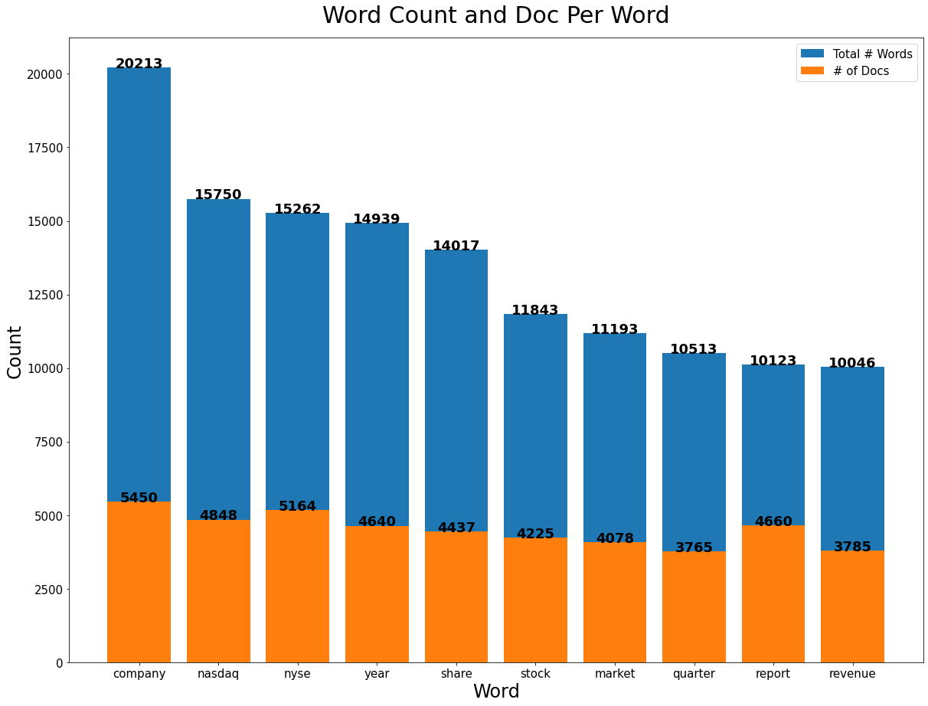
Word Counts Across All Documents (Preprocessed)

Slide 30
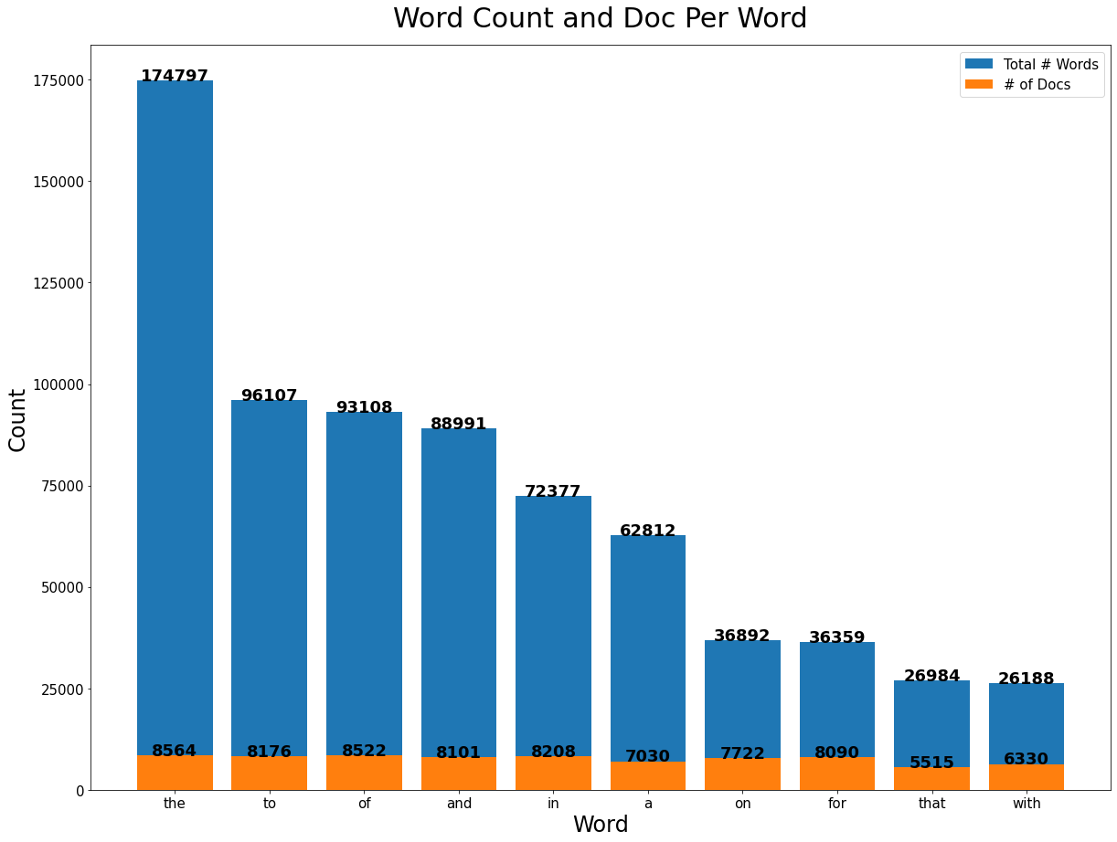
Word Counts Across All Documents (Preprocessed)

Slide 31
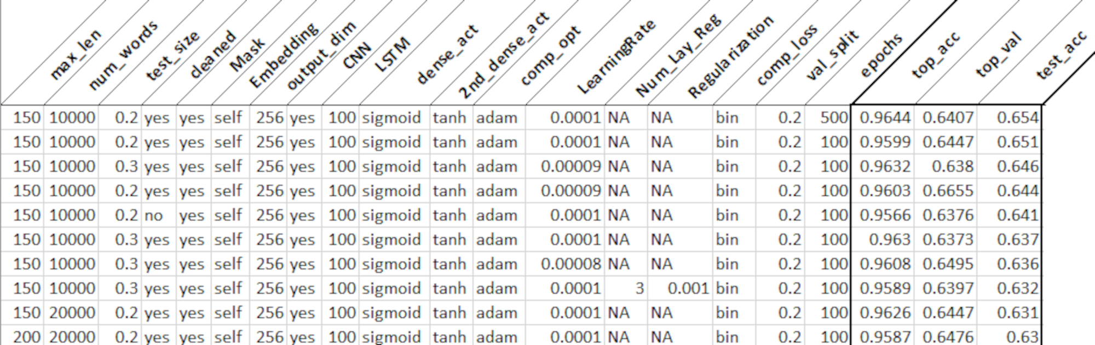
Top 10 Models Overall

Slide 32
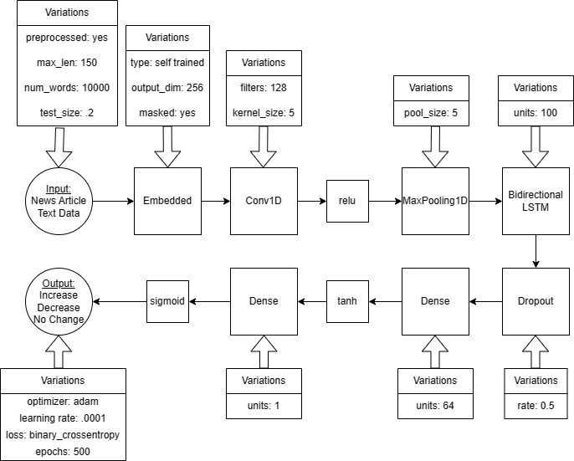
Best Model Architecture

Slide 33
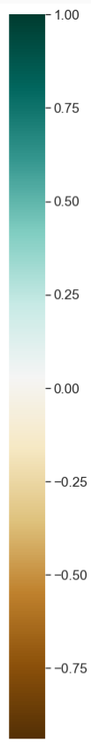
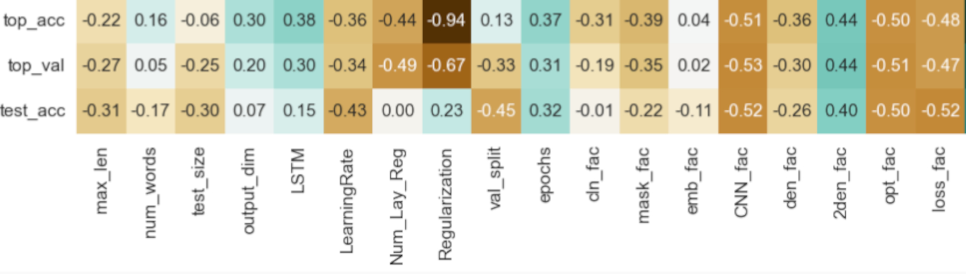
Variable Correlation

Slide 34
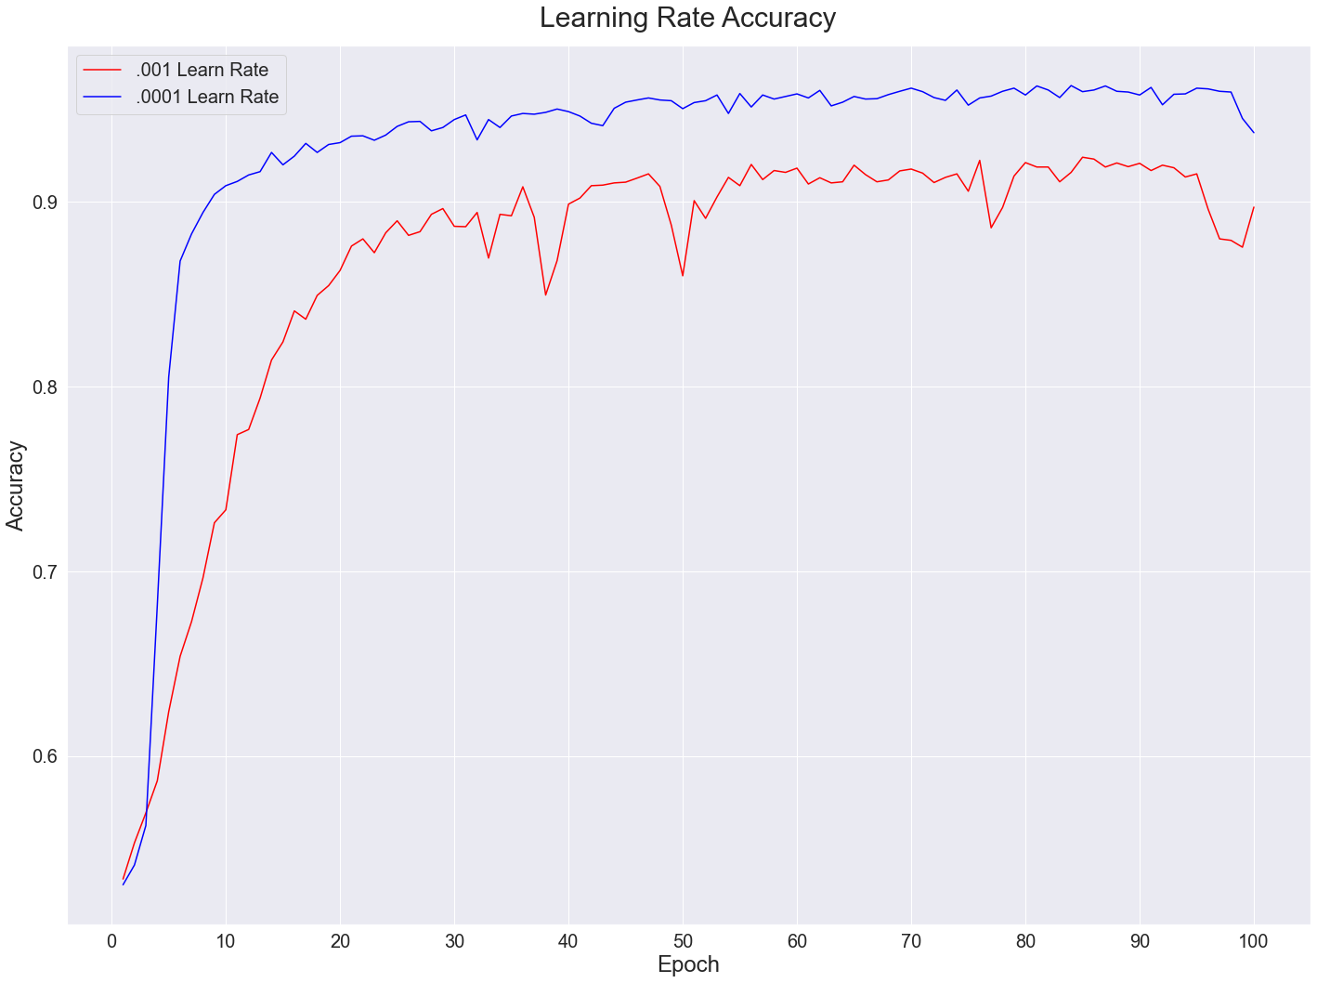
Learning Rate Effect on Accuracy

Slide 35
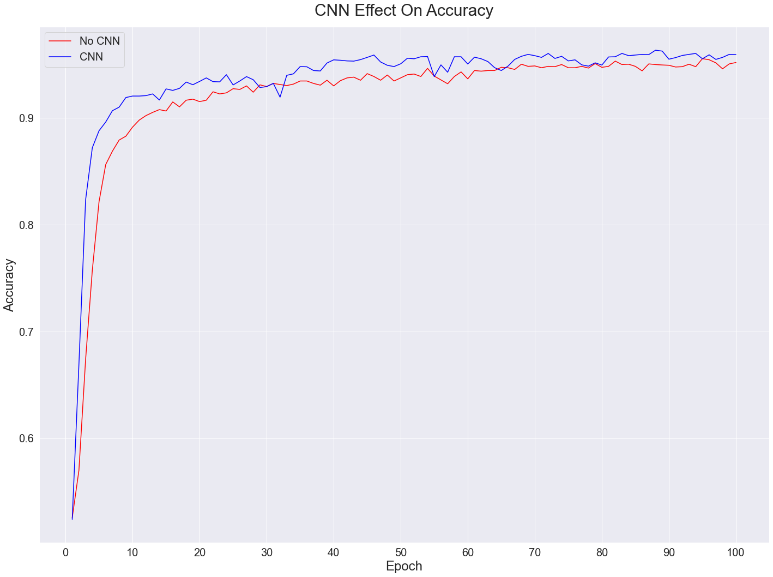
CNN Rate Effect on Accuracy

Slide 36
Text Mining Conclusions
Using a self-trained embedding layer increased accuracy but also run time.
Combining embedding, CNN, and RNN layers is beneficial.
Reducing the learning rate can assist in avoiding overfitting.
Cleaning the data helped with performance, but it may not be necessary for accuracy.
Allowing for too many words/sequences did not result in better accuracy (football field analogy)
Additional/more granular data most likely needed to achieve actionable results.
Look at exact time of day of article release (was it after closing, before closing, etc.)
Article released on Friday vs. other weekday, right before holidays, etc.

Slide 37
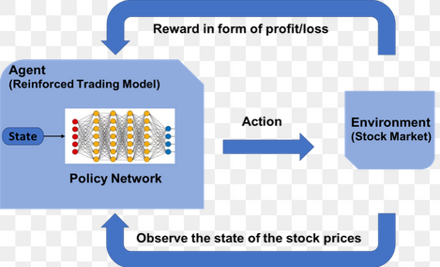
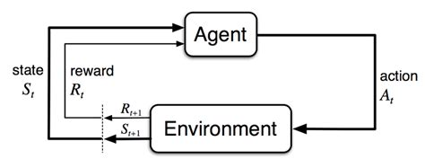
Deep Reinforcement Learning (DRL)

Slide 38
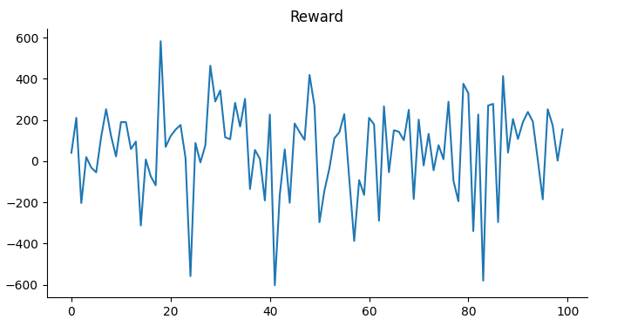
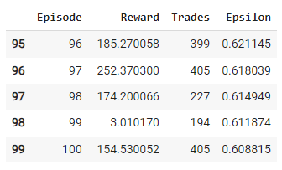
DRL over NVDA Stock 1/1/2021 to 11/01/2023 Agent Environment Reward Policy

Slide 39



Rewards, Epsilon Decay and Number of Trades over 100 Episodes

Slide 40



Rewards, Epsilon Decay and Number of Trades over 500 Episodes

Slide 41



Rewards, Epsilon Decay and Number of Trades over 500 Episodes + Indicators (MACD, RSI, BBand and SMA (50 + 200)

Slide 42


LSTM over NVDA
Period: 01-01-2021 TO 01-11-2023
80-20 test split
2 - 50 units hidden layers
1 Dense unit
30 epochs
Adam optimizer
Learning rate
Cumulative returns of 5,300.00
29 total trades
Notes:
The LSTM-based predictive model described in the code has the following specifications:
Model Type: Sequential LSTM (Long Short-Term Memory), which is well-suited for time series forecasting because it can capture long-term dependencies and patterns in data.
Input Data: The model takes the normalized closing price of a stock for the last five days as input. This input is reshaped to be compatible with the LSTM's expected three-dimensional format: [samples, time steps, features].
Neural Network Architecture:
The first LSTM layer has 50 units and returns sequences, meaning it outputs a sequence to the next layer rather than a single value.
The second LSTM layer also has 50 units but does not return sequences, which is typical for the final LSTM layer in a sequence prediction.
A Dense output layer with a single unit produces the prediction for the next closing price.
Regularization: No explicit regularization like dropout is mentioned in the code provided. However, Dropout layers can be included between LSTM layers to prevent overfitting.
Compilation:
The model uses the Adam optimizer, a popular choice for training neural networks due to its efficiency and adaptive learning rate properties.
Mean Squared Error (MSE) is used as the loss function, which is standard for regression problems.
Training:
The LSTM model is trained for 30 epochs, which defines how many times the learning algorithm will work through the entire training dataset.
A batch size of 32 is used, which determines the number of samples that will be propagated through the network before updating the model parameters.
Output: The model predicts the next closing price of the stock. These predictions are then inversely transformed to bring them back to the original price scale.
Evaluation Strategy: The model's predictions are used in a trading strategy where positions are taken based on the predicted and actual price movements. The cumulative returns from this strategy are tracked to evaluate the model's effectiveness.
Visualization: The predictions and actual stock prices are plotted to visually assess the model's performance.
This LSTM model is relatively simple and may serve as a baseline for more complex trading strategies. Additional layers, different numbers of neurons, or other types of layers could be added to potentially improve performance. Hyperparameter tuning and cross-validation could also be employed to optimize the model further.

Slide 43


LSTM + DRL over NVDA
Period: 01-01-2021 TO 01-11-2023
80-20 test split
2 - 50 units hidden layers
1 Dense unit
30 epochs
Adam optimizer
Learning rate 0.001
1 Input seq layer (24 units)
2 Hidden layers (24 units)
ReLU activation function
Output linear layer = (24, 3)
Max Return of ~550.00
Notes:
The LSTM-based predictive model described in the code has the following specifications:
Model Type: Sequential LSTM (Long Short-Term Memory), which is well-suited for time series forecasting because it can capture long-term dependencies and patterns in data.
Input Data: The model takes the normalized closing price of a stock for the last five days as input. This input is reshaped to be compatible with the LSTM's expected three-dimensional format: [samples, time steps, features].
Neural Network Architecture:
The first LSTM layer has 50 units and returns sequences, meaning it outputs a sequence to the next layer rather than a single value.
The second LSTM layer also has 50 units but does not return sequences, which is typical for the final LSTM layer in a sequence prediction.
A Dense output layer with a single unit produces the prediction for the next closing price.
Regularization: No explicit regularization like dropout is mentioned in the code provided. However, Dropout layers can be included between LSTM layers to prevent overfitting.
Compilation:
The model uses the Adam optimizer, a popular choice for training neural networks due to its efficiency and adaptive learning rate properties.
Mean Squared Error (MSE) is used as the loss function, which is standard for regression problems.
Training:
The LSTM model is trained for 30 epochs, which defines how many times the learning algorithm will work through the entire training dataset.
A batch size of 32 is used, which determines the number of samples that will be propagated through the network before updating the model parameters.
Output: The model predicts the next closing price of the stock. These predictions are then inversely transformed to bring them back to the original price scale.
Evaluation Strategy: The model's predictions are used in a trading strategy where positions are taken based on the predicted and actual price movements. The cumulative returns from this strategy are tracked to evaluate the model's effectiveness.
Visualization: The predictions and actual stock prices are plotted to visually assess the model's performance.
This LSTM model is relatively simple and may serve as a baseline for more complex trading strategies. Additional layers, different numbers of neurons, or other types of layers could be added to potentially improve performance. Hyperparameter tuning and cross-validation could also be employed to optimize the model further.

Slide 44


LSTM + RL Portfolio
Combined Cumulative Returns starting with 50K from 1/1/2021 to 1/11/2023
Rewards per Stock over Episodes

Slide 45


LSTM Portfolio
Combined Cumulative Returns starting with 50K for period 1/1/2021 to 1/11/2023
Returns per individual stock
Notes:
For fame of reference here is the

Slide 46
DRL & DRL + LSTM Combination- Conclusions
DRL successfully learned to make buy sell and hold decisions based on its environment
Increasing the number of episode improved the overall profitability
More features did not result in better results
Combining with LSTM significantly increased complexity but did not improve overall results
Employing multiple agents to a portfolio setting did not produce better results
Further exploration using larger datasets is recommended

Slide 47
Summary of key findings from each approach
Lessons learned from the project
Future directions and potential improvements
Image: Roadmap for Future Research

